Slide 1






Foundations of
Quantum Information Science (QIS 101)
Dave Biersach
Brookhaven National Laboratory
dbiersach@bnl.gov
Session 08
Early Quantum
Mechanics

Slide 2
Session 08 – Goals
Understand how double-slit diffraction enables the measurement of photon wavelengths
Predict the spectral emission lines of the Hydrogen atom using the Rydberg Formula
Discuss the evolution of the early atomic models
Develop the Bohr Atomic Model for Hydrogen
Calculate spectral lines using the Bohr Atomic Model
Compare the Rydberg Formula to the Bohr Model
Consider why the Bohr Model was ultimately replaced

Slide 3
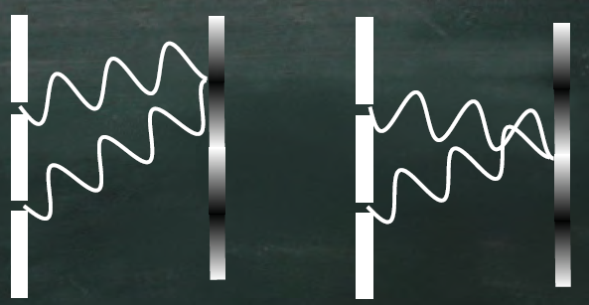
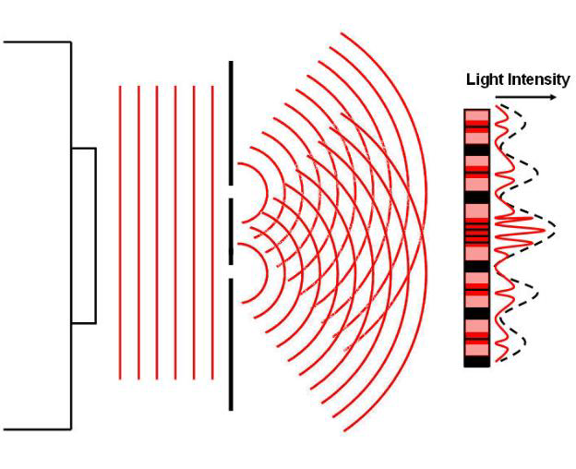
Double Slit Diffraction

Slide 4
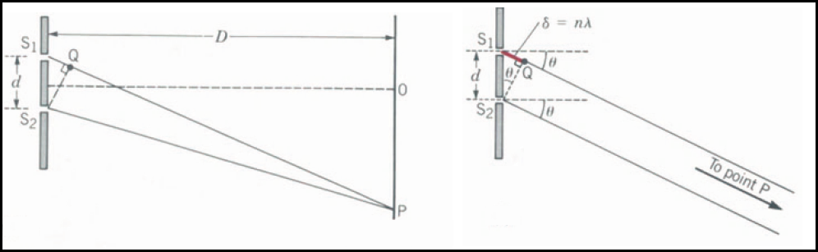

Double Slit Diffraction
For constructive interference:
$$d\sin{θ}=nλ$$
Wavelengths $(λ$) of four visible emission lines after heating pure Hydrogen
$$λ=\frac{d\sin{θ}}{n}$$

Slide 5
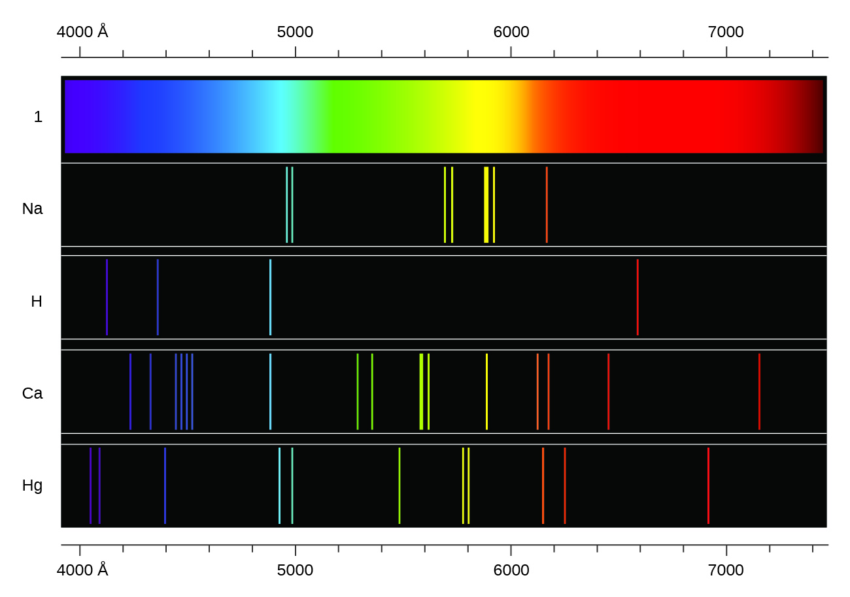
Spectral Emission Lines

Slide 6
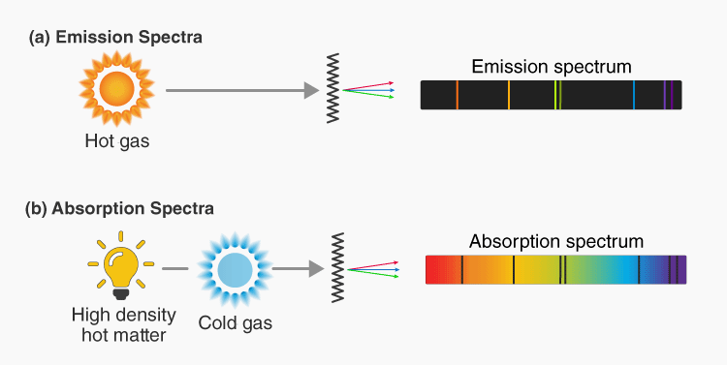
Emission vs. Absorption Spectra

Slide 7
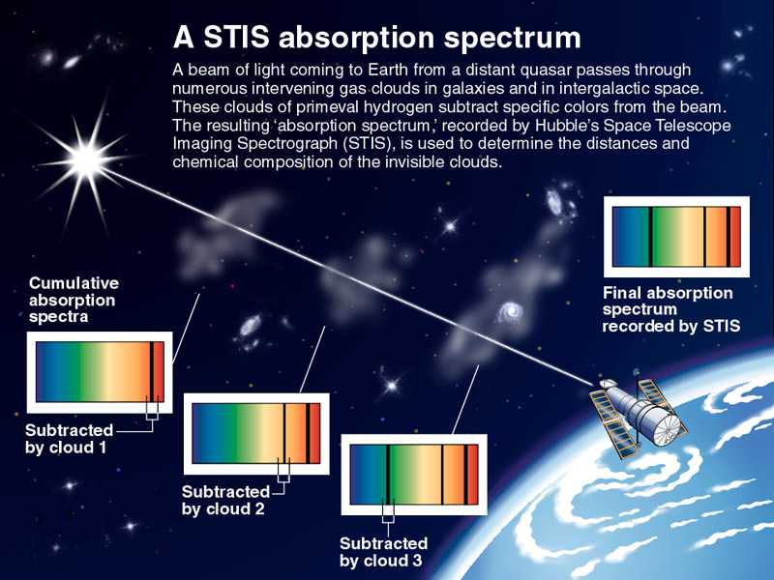

Slide 8
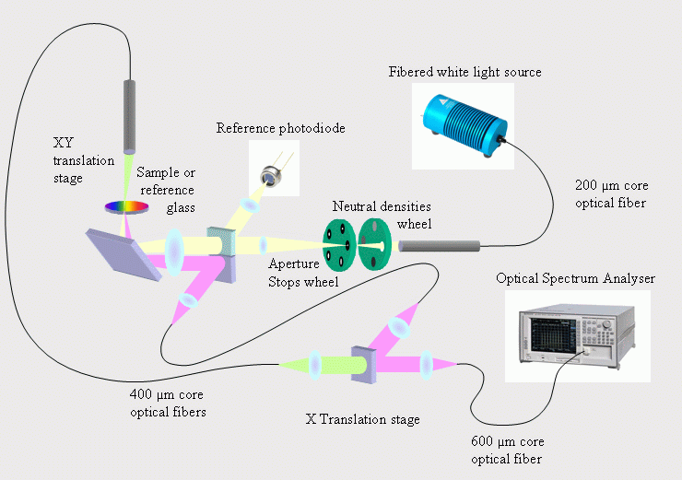
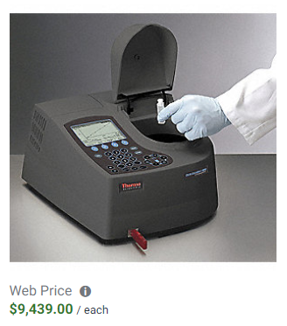
Reflectance Spectrophotometry

Slide 9
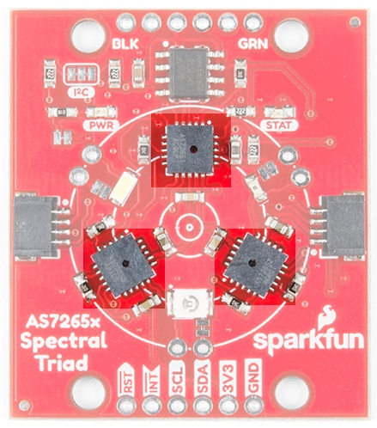

The SparkFun Triad Sensor
The sensor talks to
the computer over a serial (UART) port
Ultraviolet
Near Infrared
Visible Light

Slide 10
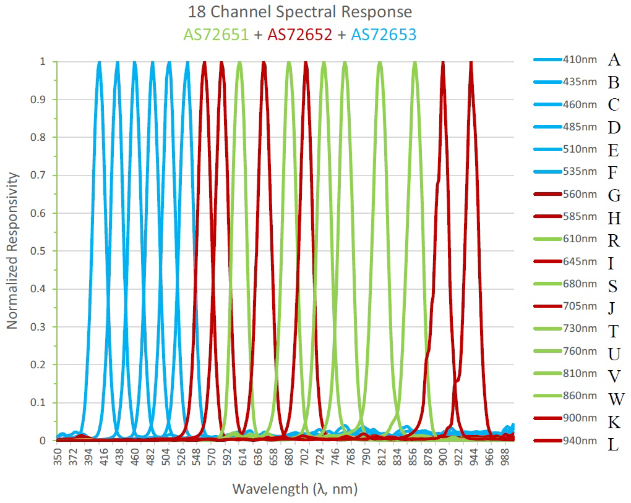
The SparkFun Triad Sensor
$$↓λ=↑E$$
←Increasing Energy
Ultraviolet
Visible Light
Near Infrared

Slide 11
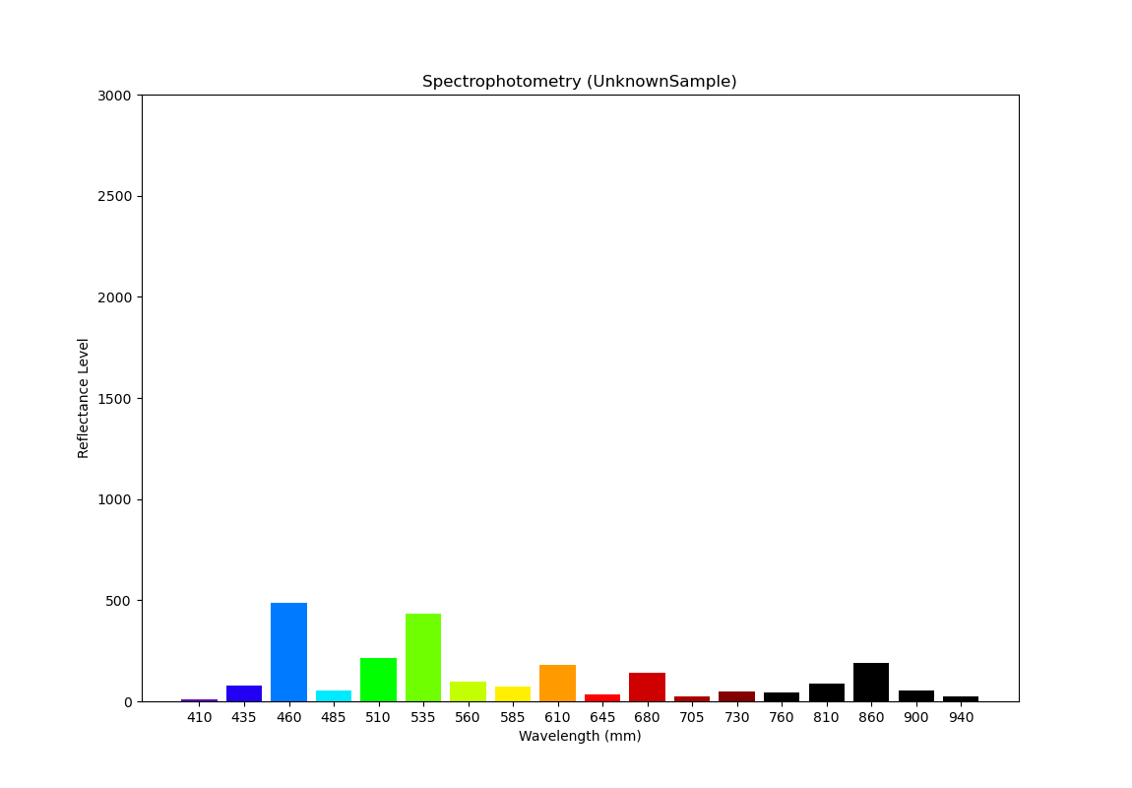
Reflectance Spectra for Acrylic
Why do museums use Acrylic coverings on paintings?

Slide 12
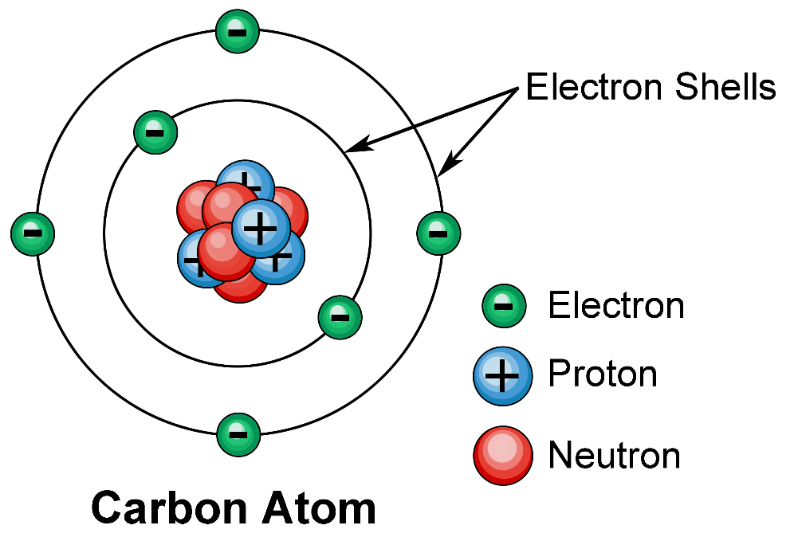
The Atomic Shell Model

Slide 13
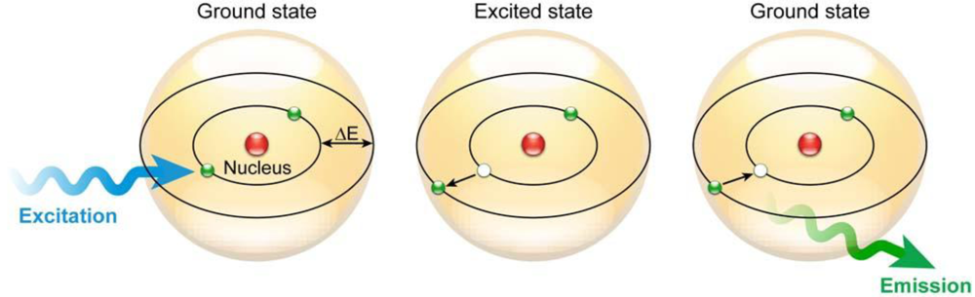
The Atomic Shell Model

Slide 14
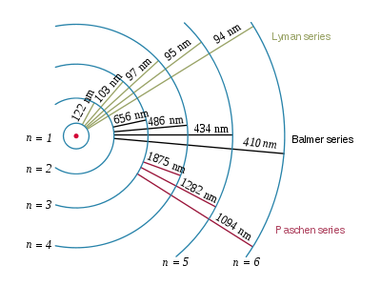
Spectral Emission Lines
Hydrogen Emission Lines
Johann Balmer 1885
When an electron transitions to a lower energy orbit, it emits a photon of light having a wavelength $λ$
(ultraviolet)
(visible)
Initial orbit
(infrared)
Final orbit
$$nm=1×{10}^{−9}m$$
$$Å=1×{10}^{−10}m$$

Slide 15
Spectral Emission Lines
Hydrogen Emission Lines
Rydberg Formula
$$\frac{1}{λ}=R\left(\frac{1}{n_{k}^{2}}−\frac{1}{n_{j}^{2}}\right)$$ $k,j∈ℤ^{+} and j>k$
(ultraviolet)
$$Rydberg Constant \\ R=1.0967757×{10}^{7}m^{−1}$$
(visible)
Initial orbit
(infrared)
Final orbit
$n_{j}=$ Initial orbit #
$n_{k}=$ Final orbit #

Slide 16
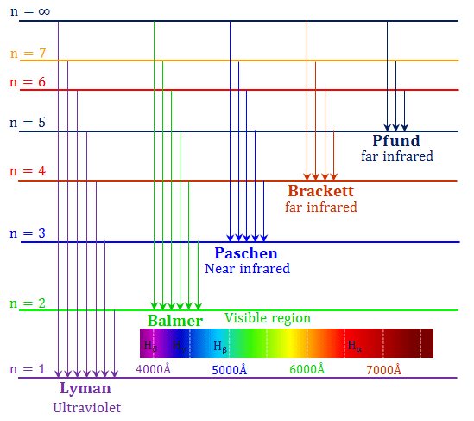
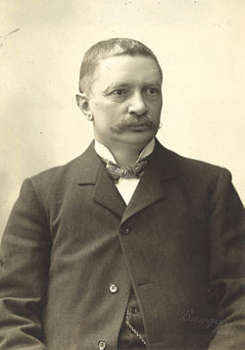
Spectral Emission Lines
Rydberg Formula
$$\frac{1}{λ}=R\left(\frac{1}{n_{k}^{2}}−\frac{1}{n_{j}^{2}}\right)$$ $k,j∈ℤ^{+} and j>k$
$$Rydberg Constant \\ R=1.0967757×{10}^{7}m^{−1}$$
Johannes Rydberg
(1865 – 1919)

Slide 17
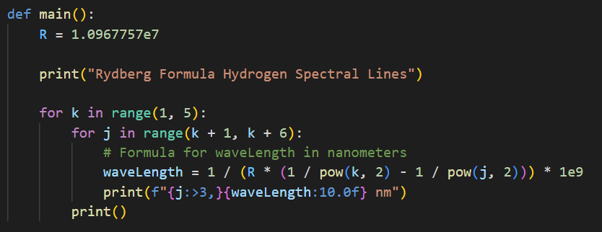
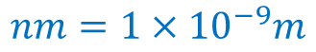
Open spectrum_rydberg.py
①
②
③
④
⑤
⑥
Rydberg Formula
$$nm=1×{10}^{−9}m$$
$$\frac{1}{λ}=R\left(\frac{1}{n_{k}^{2}}−\frac{1}{n_{j}^{2}}\right)$$ $k,j∈ℤ^{+} and j>k$
$$Rydberg Constant \\ R=1.0967757×{10}^{7}m^{−1}$$

Slide 18
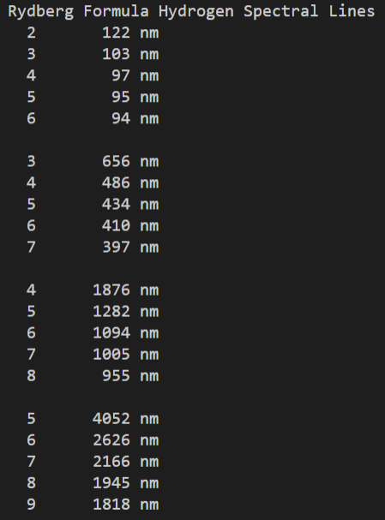
Run spectra_rydberg
Lyman
Balmer
Paschen
Brackett
$$\frac{1}{λ}=R\left(\frac{1}{n_{k}^{2}}−\frac{1}{n_{j}^{2}}\right)$$

Slide 19
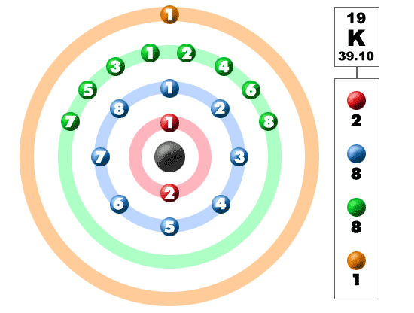
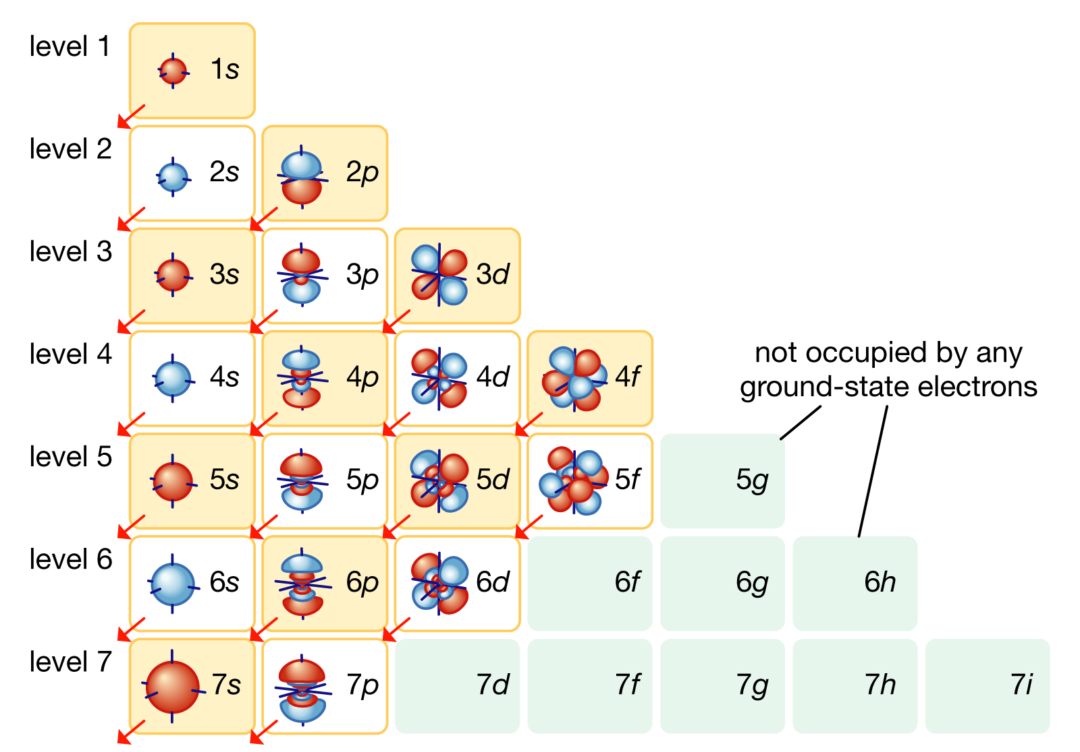
Electron Shells – Periodic Table
Why did we pick the letters s, p, d, f ??

Slide 20
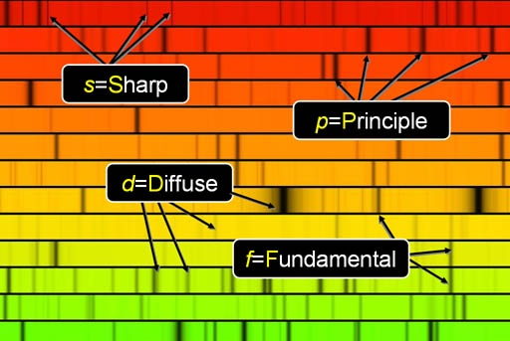

Spectral Absorption Lines
The s, p, d, f
come from the way the absorption spectra lines “look”

Slide 21
Formulas $≠$ Physics
Rydberg developed his formula in 1888 and it was later extended by Ritz to account for all known atoms
But it is still only an empirical formula – there was no explanation given as to why the formula worked
Fitting a curve mathematically and then making accurate predictions is still not physics if you don’t understand the underlying physical laws that lead to the equation
It took the next 50 years for science to understand the true nature of the formula and to realize the source of Rydberg’s constant

Slide 22
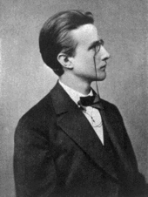
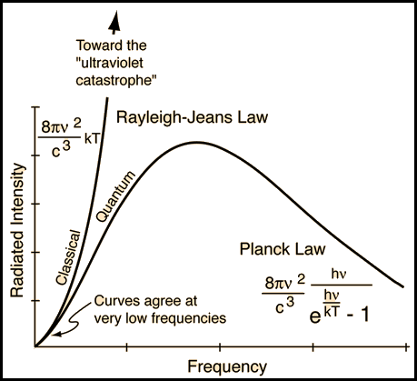
Max Planck’s Law - 1900
Increasing energy
Classical theory could not explain the observed spectra
$$c=speed of light \\ ν=frequency of wave \\ T=absolute temperature$$
$$h=Planck^{′}s constant \\ =6.63×{10}^{−34}Jsec$$
Energy is quantized!
It comes in packets of $hν$

Slide 23

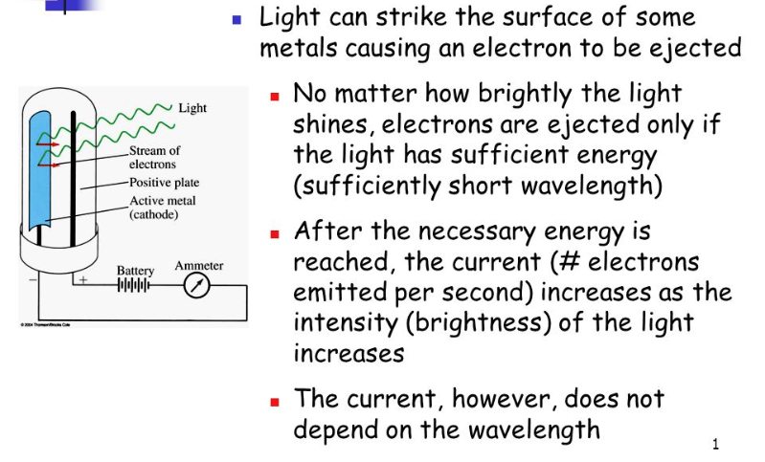

Einstein’s Photon Quantum - 1905

Slide 24
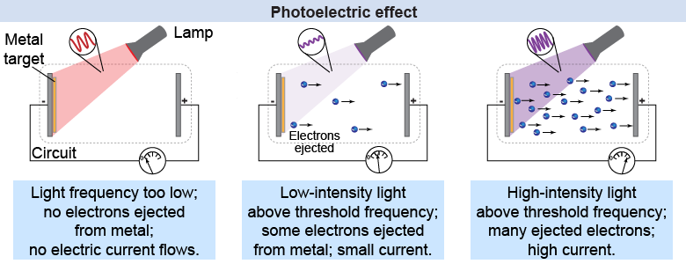
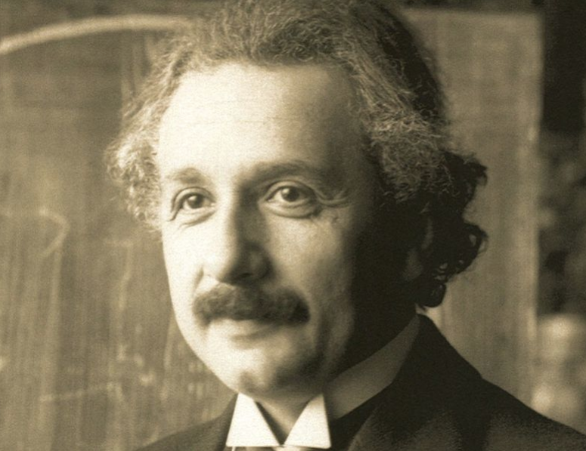
Einstein’s Photon Quantum - 1905
$$E_{photon}=\frac{hc}{λ}$$

Slide 25
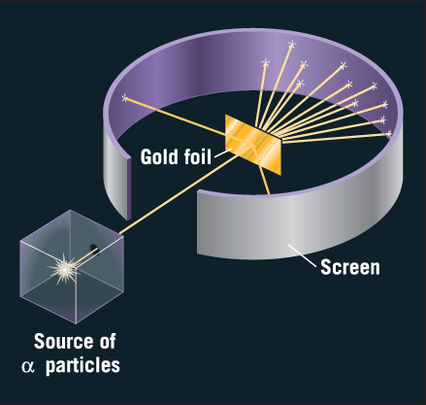
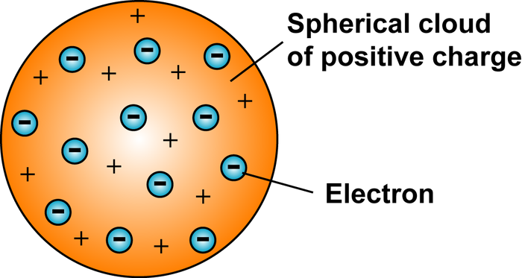
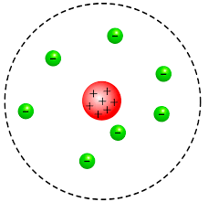
Early Atomic Models
J.J Thomson (1904)
E. Rutherford Experiment (1911)
But if like charges repel, then what keeps the protons close together?
Rutherford scattering indicated atoms have a heavy & compact nucleus

Slide 26
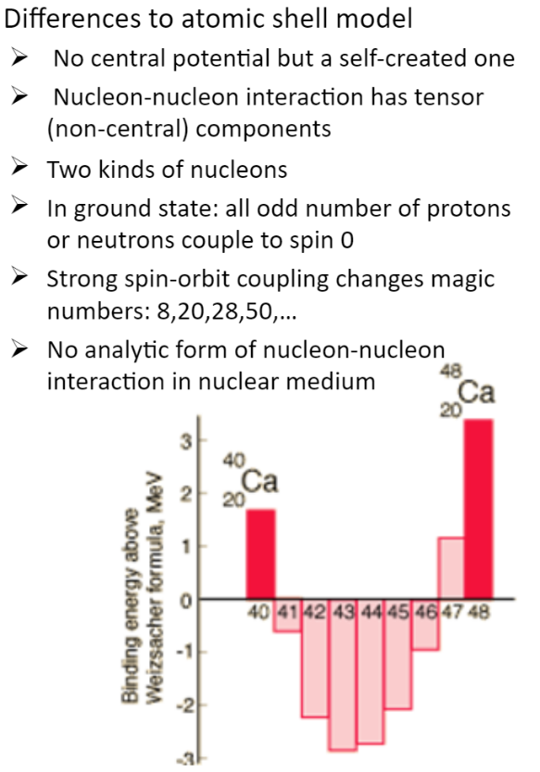
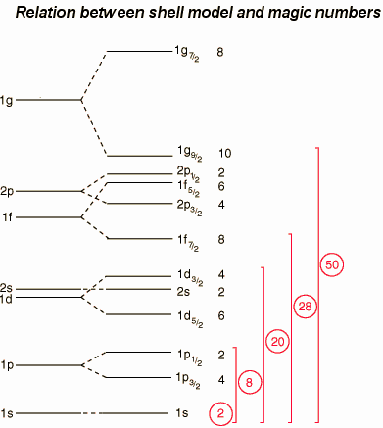
The Nuclear Shell Model

Slide 27
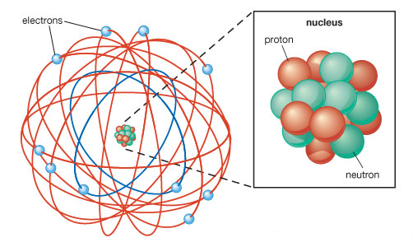
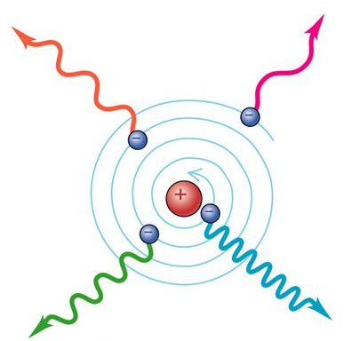
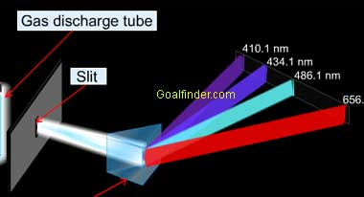
Early Atomic Models
The Rutherford model required even stable atoms to constantly emit radiation (but they don’t) and it could not explain discrete spectral emission lines

Slide 28
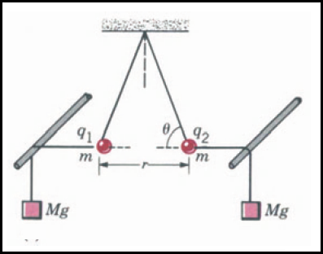
Atomic Model – N. Bohr - 1913
$$Coulomb^{′}s Law$$
$$F∝\frac{q_{1}q_{2}}{r^{2}}⟹F=k\frac{q_{1}q_{2}}{r^{2}}$$
$$k=\frac{1}{4πε_{0}} (Coulomb^{′}s constant)$$
Eq 1
$$F=\frac{q_{1}q_{2}}{4πε_{0}r^{2}}$$
$q=$ Electric charge
$ℰ_{0}=$Permittivity of free space
Electric Field Potential
$$E=\frac{q_{1}q_{2}}{4πε_{0}}\left[\frac{1}{r_{A}}−\frac{1}{r_{B}}\right]$$
$$W_{A→B}=\int_{A}^{B}{Fⅆs}$$
q2
B
A
A as reference point $∴$ $r_{B}=∞$
$$E\left(r\right)=\frac{q_{1}q_{2}}{4πε_{0}}\int_{A}^{B}{\frac{1}{r^{2}}ⅆr}$$
q1
$$E_{A}=\frac{q_{1}q_{2}}{4πε_{0}r_{A}}$$
Eq 2
$$\int{\frac{1}{r^{2}}=−\frac{1}{r}}$$
$$\frac{−1}{r_{B}}−\frac{−1}{r_{A}}=\frac{1}{r_{A}}−\frac{1}{r_{B}}$$

Slide 29
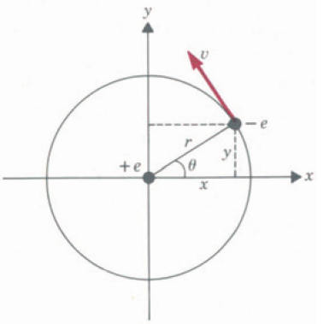
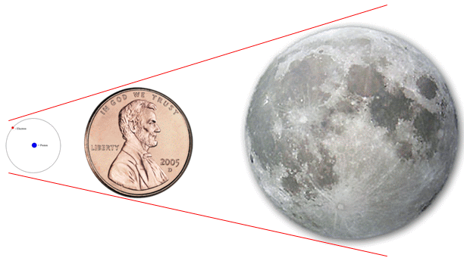
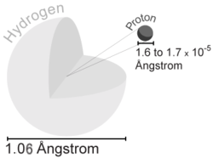
Atomic Model – N. Bohr - 1913
To stay
“in orbit”
Blue = Red
$$v=n\frac{ℏ}{mr}$$
Bohr: Angular momentum $L$is quantized and is a multiple $n$of Plank’s constant $ℏ$
$$L=mvr=nℏ$$
$$\frac{1}{4πε_{0}}\frac{e^{2}}{r^{2}}=\frac{m}{r}n^{2}\frac{ℏ^{2}}{m^{2}r^{2}}$$
$$r=n^{2}\frac{4πε_{0}ℏ^{2}}{e^{2}m}$$
$$ℏ=\frac{h}{2π}$$
Eq 4
$$F=\frac{q_{1}q_{2}}{4πε_{0}r^{2}}$$
Eq 1
$$r=\frac{(1.11×\frac{{10}^{−10}C^{2}}{Nm^{2}}){(1.05×{10}^{−34}Jsec)}^{2}}{{\left(1.6×{10}^{−19}C\right)}^{2}(9.1×{10}^{−31}kg)}$$
$$n=1$$
$$q_{electron}=−e \\ q_{proton}=+e$$
$$r=0.53×{10}^{−10}=0.53 Å$$
$$F_{radial}=m{∗a}_{radial}$$
$$\frac{1}{4πε_{0}}\frac{e^{2}}{r^{2}}=m\frac{v^{2}}{r}$$
Eq 3

Slide 30
Atomic Model – N. Bohr - 1913
Eq 2
$$E=\frac{q_{1}q_{2}}{4πε_{0}r}$$
$$E_{TOTAL}=kinetic +potential$$
$$E_{TOTAL}=\frac{1}{2}mv^{2}−\frac{1}{4πε_{0}}\frac{e^{2}}{r}$$
Potential is negative because
$$q_{1}=−e \& q_{2}=e$$
$$E_{TOTAL}=\frac{1}{2}\left[\frac{1}{4πε_{0}}\frac{e^{2}}{r}\right]−\left[\frac{1}{4πε_{0}}\frac{e^{2}}{r}\right]$$
Eq 3
$$\frac{1}{4πε_{0}}\frac{e^{2}}{r^{2}}=m\frac{v^{2}}{r}$$
$$E_{TOTAL}=−\frac{1}{2}\left[\frac{1}{4πε_{0}}\frac{e^{2}}{r}\right]$$
$$\frac{r}{2}\left[\frac{1}{4πε_{0}}\frac{e^{2}}{r^{2}}\right]=\frac{r}{2}\left[m\frac{v^{2}}{r}\right]$$
$$r=n^{2}\frac{4πε_{0}ℏ^{2}}{e^{2}m}$$
$$h=2πℏ$$
Eq 4
$$\frac{1}{2}mv^{2}=\frac{1}{2}\left[\frac{1}{4πε_{0}}\frac{e^{2}}{r}\right]$$
$$E_{n}=−\frac{e^{4}m}{8ε_{0}^{2}h^{2}}\frac{1}{n^{2}}$$
$$n=orbit \#$$
Eq 5

Slide 31
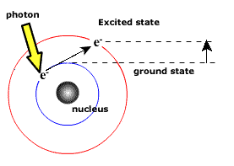
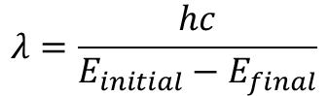
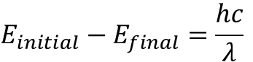
Atomic Model – N. Bohr - 1913
$$E_{n}=−\frac{e^{4}m}{8ε_{0}^{2}h^{2}}\frac{1}{n^{2}}$$
Eq 5
$$E_{0}=\frac{e^{4}m}{8ε_{0}^{2}h^{2}}$$
$E_{0}=$Just the constants
$$E_{n}=−\frac{E_{0}}{n^{2}},n=1,2,3,…$$
$$n=orbit \#$$
$$E_{initial}−E_{final}=\frac{hc}{λ}$$
Einstein’s Photon Energy Quantum
When an electron falls back to its ground state, it will emit a photon at the wavelength associated with the corresponding energy delta
$$λ=\frac{hc}{E_{initial}−E_{final}}$$

Slide 32
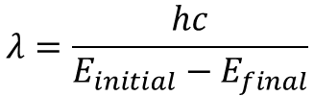
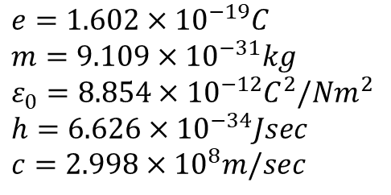
Bohr Spectra for Hydrogen
Write a Python application to display the predicted wavelengths for the spectral emission of the Hydrogen atom using Bohr’s Atomic model
$$e=1.602×{10}^{−19}C \\ m=9.109×{10}^{−31}kg \\ ε_{0}=8.854×{10}^{−12}C^{2}/Nm^{2} \\ h=6.626×{10}^{−34}Jsec \\ c=2.998×{10}^{8}m/sec$$
$$E_{0}=\frac{e^{4}m}{8ε_{0}^{2}h^{2}}$$
$$E_{n}=−\frac{E_{0}}{n^{2}}, n=1,2,3,…$$
$$n=orbit \#$$
Note: The SI unit for distance is meters (m) but we want the results shown in nanometers (nm)
$$λ=\frac{hc}{E_{initial}−E_{final}}$$

Slide 33
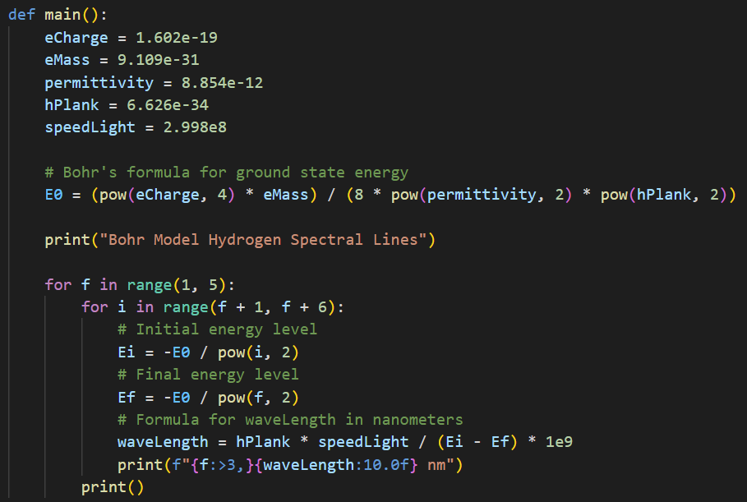
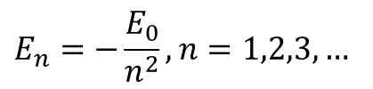
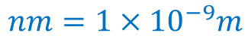
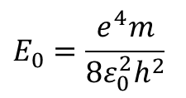

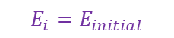
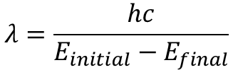

Open spectrum_bohr.py
$$E_{0}=\frac{e^{4}m}{8ε_{0}^{2}h^{2}}$$
$$E_{n}=−\frac{E_{0}}{n^{2}}, n=1,2,3,…$$
$$n=orbit \#$$
①
②
③
④
⑤
⑥
⑦
⑧
⑨
$$λ=\frac{hc}{E_{initial}−E_{final}}$$
$$E_{i}=E_{initial}$$
$$nm=1×{10}^{−9}m$$
$$E_{f}=E_{final}$$

Slide 34

Run spectrum_bohr.py
Lyman Series
Balmer Series
Paschen Series
Brackett Series

Slide 35



Atomic Model – N. Bohr - 1913
$$E_{n}=−\frac{e^{4}m}{8ε_{0}^{2}h^{2}}\frac{1}{n^{2}}$$
Eq 5
$$E_{initial}−E_{final}=\frac{hc}{λ}$$
$$E_{n}=−\frac{E_{0}}{n^{2}},n=1,2,3,…$$
$$\left(−\frac{E_{0}}{n_{i}^{2}}\right)−\left(−\frac{E_{0}}{n_{f}^{2}}\right)=\frac{hc}{λ}$$
$$E_{0}=\frac{e^{4}m}{8ε_{0}^{2}h^{2}}$$
$i,f∈ℤ^{+} and i>f$
j, i = initial
$$\frac{1}{λ}=\frac{E_{0}}{hc}\left(\frac{1}{n_{f}^{2}}−\frac{1}{n_{i}^{2}}\right)$$
Rydberg Formula
$$\frac{1}{λ}=R\left(\frac{1}{n_{k}^{2}}−\frac{1}{n_{j}^{2}}\right)$$
k, f = final
$$R_{Bohr}=\frac{E_{0}}{hc}=\frac{e^{4}m}{8ε_{0}^{2}h^{3}c}$$
$$Rydberg Constant \\ R=1.0967757×{10}^{7}m^{−1}$$
$$R_{Bohr}=1.0968968×{10}^{7}m^{−1}$$

Slide 36


Atomic Model – N. Bohr - 1913
Rydberg Formula
Bohr Formula
$$\frac{1}{λ}=R\left(\frac{1}{n_{k}^{2}}−\frac{1}{n_{j}^{2}}\right)$$ $where k,j∈ℤ^{+} and j>k$
$$\frac{1}{λ}=R_{Bohr}\left(\frac{1}{n_{f}^{2}}−\frac{1}{n_{i}^{2}}\right)$$ $where f,i∈ℤ^{+} and i>f$
$$Rydberg Constant \\ R=1.0967757×{10}^{7}m^{−1}$$
$$Bohr Constant \\ R_{Bohr}=1.0968968×{10}^{7}m^{−1}$$
Now we are doing physics!
With Bohr’s model we can assemble a logical sequence of physical laws to derive an empirical rule!

Slide 37


Bohr Didn’t Include Electron “Spin”
1924

Slide 38
Session 08 – Know You Know…
Double-slit diffraction enables measurement of wavelengths
The Rydberg Formula indicated an underlying model existed, but an equation without an explanation is just a nifty observation
Consider the plight of early atomic models – how do you measure something you cannot possibly see?
At the atomic level, Mother Nature is quantized – this violates common experience with continuous spectrums
Don’t be scared off by a soup of complex looking symbols and a long series of equations – learn to glide with them!

Slide 39
Task 08-01
Create a Python program called hydrogen_spectrum.py that calculates and displays the wavelengths (in nanometers) for both the Pfund and Humphreys high energy spectral series of Hydrogen
Your program should calculate and display the wavelengths for both series using both the Rydberg and Bohr formulas
Upload your solution to the BNL QIS101 SharePoint site

